Slide 1
LOGIC GATES
Formal logic: In formal logic, a statement (proposition) is a declarative sentence that is either
true(1) or false (0).
It is easier to communicate with computers using formal logic.
• Boolean variable: Takes only two values – either
true (1) or false (0).
They are used as basic units of formal logic.

Slide 2
Boolean function and logic diagram
• Boolean function: Mapping from Boolean variables to a Boolean value.
• Truth table:
  Represents relationship between a Boolean function and its binary variables.
  It enumerates all possible combinations of arguments and the corresponding function values.

Slide 3
Boolean function and logic diagram
• Boolean algebra: Deals with binary variables and logic operations operating on those variables.
• Logic diagram: Composed of graphic symbols for logic gates. A simple circuit sketch that represents inputs and outputs of Boolean functions.

Slide 4
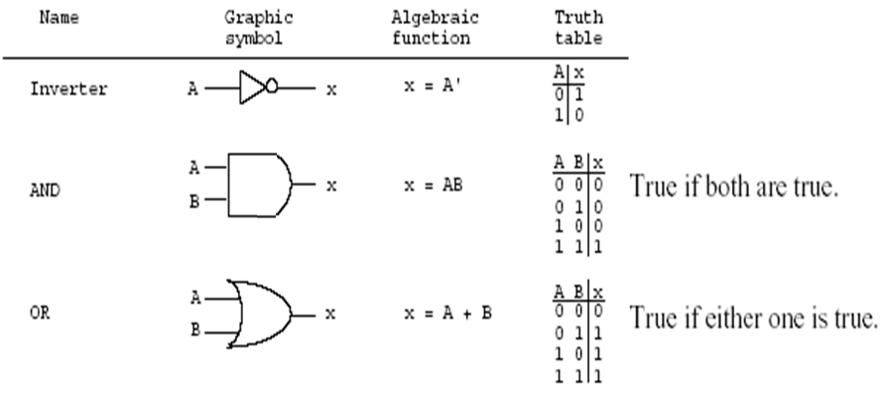
Gates
Refer to the hardware to implement Boolean operators.
The most basic gates are

Slide 5
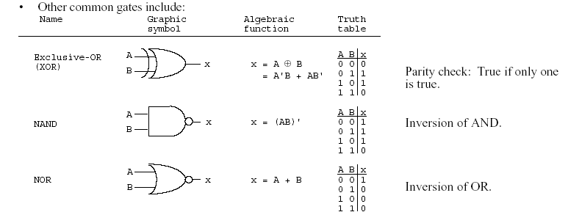
Boolean function and truth table

Slide 6
BASIC IDENTITIES OF BOOLEAN ALGEBRA
Postulate 1 (Definition): A Boolean algebra is a closed algebraic system containing a set K of two or more elements and the two operators · and + which refer to logical AND and logical OR

Slide 7
Basic Identities of Boolean Algebra
(Existence of 1 and 0 element)
x + 0 = x
x · 0 = 0
x + 1 = 1
x · 1 = 1
(Table 1-1)

Slide 8
Basic Identities of Boolean Algebra (Existence of complement)
(5) x + x = x
(6) x · x = x
(7) x + x’ = x
(8) x · x’ = 0

Slide 9
Basic Identities of Boolean Algebra (Commutativity):
(9) x + y = y + x
(10) xy = yx

Slide 10
Basic Identities of Boolean Algebra (Associativity):
(11) x + ( y + z ) = ( x + y ) + z
(12) x (yz) = (xy) z

Slide 11
Basic Identities of Boolean Algebra (Distributivity):
(13) x ( y + z ) = xy + xz
(14) x + yz = ( x + y )( x + z)

Slide 12
Basic Identities of Boolean Algebra (DeMorgan’s Theorem)
(15) ( x + y )’ = x’ y’
(16) ( xy )’ = x’ + y’

Slide 13
Basic Identities of Boolean Algebra (Involution)
(17) (x’)’ = x

Slide 14
Function Minimization using Boolean Algebra
Examples:
(a) a + ab = a(1+b)=a
(b) a(a + b) = a.a +ab=a+ab=a(1+b)=a.
(c) a + a'b = (a + a')(a + b)=1(a + b) =a+b
(d) a(a' + b) = a. a' +ab=0+ab=ab

Slide 15
Try
F = abc + abc’ + a’c

Slide 16
The other type of question
Show that;
1- ab + ab' = a
2- (a + b)(a + b') = a
1- ab + ab' = a(b+b') = a.1=a
2- (a + b)(a + b') = a.a +a.b' +a.b+b.b'
= a + a.b' +a.b + 0
= a + a.(b' +b) + 0
= a + a.1 + 0
= a + a = a

Slide 17
More Examples
Show that;
(a) ab + ab'c = ab + ac
(b) (a + b)(a + b' + c) = a + bc
  (a) ab + ab'c = a(b + b'c)
  = a((b+b').(b+c))=a(b+c)=ab+ac
(b) (a + b)(a + b' + c)
= (a.a + a.b' + a.c + ab +b.b' +bc)
= …

Slide 18
DeMorgan's Theorem
(a) (a + b)' = a'b'
(b) (ab)' = a' + b'
Generalized DeMorgan's Theorem
(a) (a + b + … z)' = a'b' … z'
(b) (a.b … z)' = a' + b' + … z‘

Slide 19
DeMorgan's Theorem
F = ab + c’d’
F’ = ??
F = ab + c’d’ + b’d
F’ = ??

Slide 20
DeMorgan's Theorem
Show that: (a + b.c)' = a'.b' + a'.c'

Slide 21
More DeMorgan's example
Show that: (a(b + z(x + a')))' =a' + b' (z' + x')
  (a(b + z(x + a')))' = a' + (b + z(x + a'))'
  = a' + b' (z(x + a'))'
  = a' + b' (z' + (x + a')')
  = a' + b' (z' + x'(a')')
  = a' + b' (z' + x'a)
  =a‘+b' z' + b'x'a
  =(a‘+ b'x'a) + b' z'
  =(a‘+ b'x‘)(a +a‘) + b' z'
  = a‘+ b'x‘+ b' z‘
  = a' + b' (z' + x')

Slide 22
More Examples
(a(b + c) + a'b)'=b'(a' + c')
ab + a'c + bc = ab + a'c
(a + b)(a' + c)(b + c) = (a + b)(a' + c)

Slide 23
DeMorgan’s Theorems

Slide 24
DeMorgan’s Theorems
DeMorgan’s Theorems are two additional simplification techniques that can be used to simplify Boolean expressions. Again, the simpler the Boolean expression, the simpler the resulting logic.
A + B = A ⋅B A ⋅B = A + B
2

Slide 25








DeMorgan’s Theorem #1
A ⋅B = A + B
Proof
A ⋅B
A + B
A
A ⋅B
A ⋅B
A
A B
A + B
B
B
A | B | A ⋅B | A ⋅B
0 | 0 | 0 | 1
0 | 1 | 0 | 1
1 | 0 | 0 | 1
1 | 1 | 1 | 0
A | B | A | B | A + B
0 | 0 | 1 | 1 | 1
0 | 1 | 1 | 0 | 1
1 | 0 | 0 | 1 | 1
1 | 1 | 0 | 0 | 0
The truth-tables are equal; therefore, the Boolean equations must be equal.

Slide 26
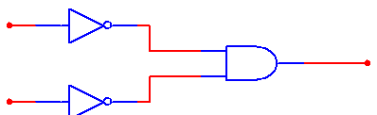

DeMorgan’s Theorem #2
A + B = A ⋅ B
Proof
A + B
A ⋅B
A
A + B
A
A B
A + B
B
A ⋅B
B
A | B | A + B | A + B
0 | 0 | 0 | 1
0 | 1 | 1 | 0
1 | 0 | 1 | 0
1 | 1 | 1 | 0
A | B | A | B | A ⋅B
0 | 0 | 1 | 1 | 1
0 | 1 | 1 | 0 | 0
1 | 0 | 0 | 1 | 0
1 | 1 | 0 | 0 | 0
The truth-tables are equal; therefore, the Boolean equations must be equal.

Slide 27
Summary
Boolean & DeMorgan’s Theorems
1) X ⋅ 0 = 0
2) X ⋅ 1 = X
3) X ⋅ X = X
4) X ⋅ X = 0
5) X + 0 = X
6) X + 1 = 1
7) X + X = X 8) X + X = 1
10A)
10B)
11A)
11B)
12A)
12B)
13A)
13B)
X ⋅ Y = Y ⋅ X X + Y = Y + X
X(YZ) = (XY)Z
Commutative Law
X + (Y + Z) = (X + Y) + Z X(Y + Z) = XY + XZ
Associative Law
(X + Y)(W + Z) = XW + XZ + YW + YZ X + XY = X + Y
Distributive Law
X + XY = X + Y
Consensus Theorem
9) X = X
13C)
13D)
X + XY = X + Y
X + XY = X + Y
14A)
14B)
X Y = X + Y
X + Y = X Y
DeMorgan’s
5

Slide 28

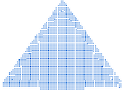





DeMorgan Shortcut
BREAK THE LINE, CHANGE THE SIGN
Break the LINE over the two variables,
and change the SIGN directly under the line.
A ⋅B = A + B
For Theorem #14A, break the line, and change the AND function to an OR function. Be sure to keep the lines over the variables.
A + B = A ⋅B
For Theorem #14B, break the line, and change the OR function to an AND function. Be sure to keep the lines over the variables.

Slide 29
DeMorgan’s: Example #1
Example
Simplify the following Boolean expression and note the Boolean or DeMorgan’s theorem used at each step. Put the answer in SOP form.
F = ( X ⋅ Y) ⋅ ( Y + Z)
1

Slide 30
DeMorgan’s: Example #1
Example
Simplify the following Boolean expression and note the Boolean or DeMorgan’s theorem used at each step. Put the answer in SOP form.
F = ( X ⋅ Y) ⋅ ( Y + Z)
Solution
1
F = ( X ⋅ Y) ⋅ ( Y + Z)
1
F = ( X ⋅ Y) + ( Y + Z)
; Theorem #14A
1
F = ( X ⋅ Y) + ( Y ⋅ Z)
; Theorem #9 & #14B
1
F = ( X ⋅ Y) + ( Y ⋅ Z)
; Theorem #9
1
F = XY + YZ
; Rewritten without AND symbols and parentheses
8
1

Slide 31


DeMorgan’s: Example #2
So, where would such an odd Boolean expression come from? Take a look at the VERY poorly designed logic circuit shown below. If you were to analyze this circuit to determine the output function F₂, you would obtain the results shown.
X
Y
XY
XY
(X + Z)(XY)
F = ( X + Z)(XY)
X
2
Z
X + Z
Example
Simplify the output function F₂. Be sure to note the Boolean or DeMorgan’s theorem used at each step. Put the answer in SOP form.

Slide 32
DeMorgan’s: Example #2
Solution
F = (X + Z)(XY)
2
F = (X + Z) + (XY)
2
F = (X + Z) + (XY)
2
F = (X Z) + (XY)
2
F = (X Z) + (XY)
2
F = X Z + X Y
2
; Theorem #14A
; Theorem #9
; Theorem #14B
; Theorem #9
; Rewritten without AND symbols

